Slide 1

The League of Lengends Store
Berty Ruan, Yusheng Wang, Jiayi Liang, Shaohua Wang, Naiqiang Lin.-----PROJECT_X

Slide 2
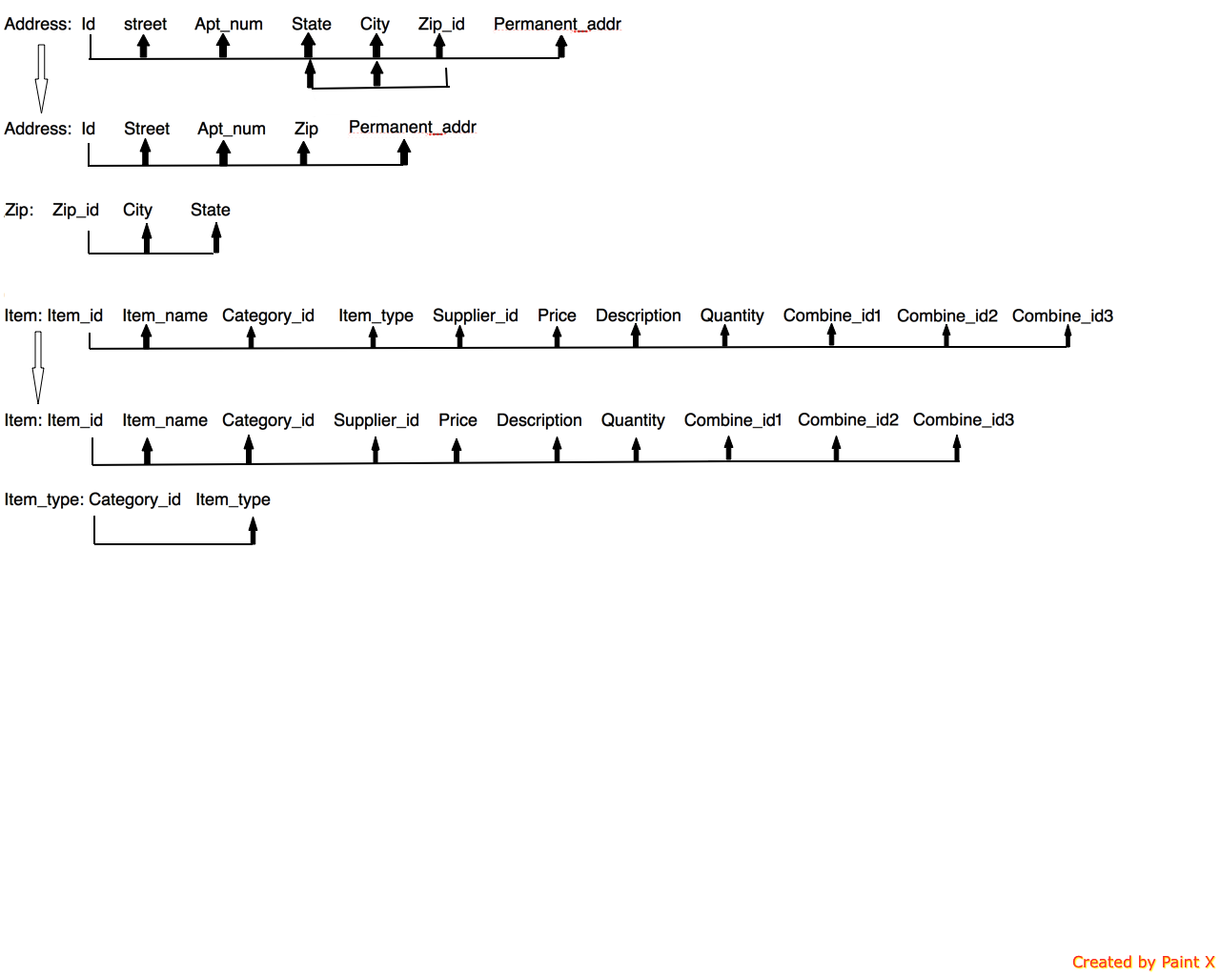

Schema Refinement

Slide 3

Technology Survey
Bootstrap
AngularJS
XAMPP Stack (with focus on PHP)

Slide 4
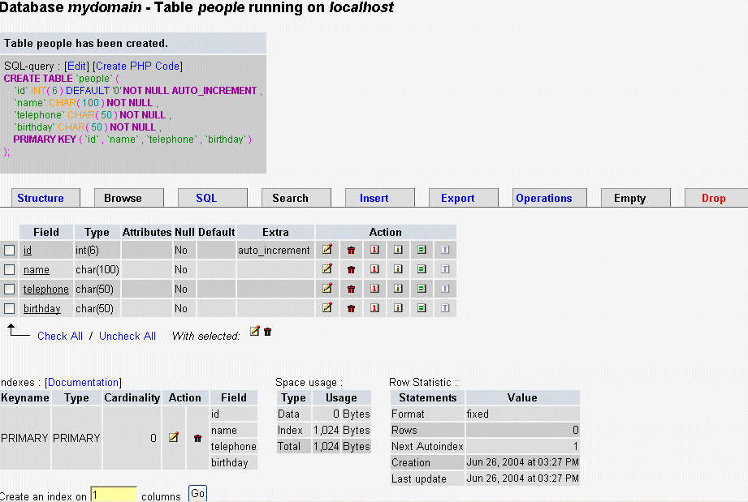

Populate Database using phpMyAdmin

Slide 5
Tasks Done
Phase 1
Phase 2
Downloaded tools to build website
Began building website

Slide 6

Action Steps
Focus on building our website
Learn PHP, AngularJS, and other tools
Use Github to collaborate on code

